Slide 1
PL/SQL

Slide 2
PL/SQL
Introduction
Structure of a block
Variables and types
Accessing the database
Control flow
Cursors
Exceptions
Procedures and functions

Slide 3
Introduction
PL/SQL stands for Procedural Language/SQL.
PL/SQL extends SQL by adding constructs found in procedural languages, resulting in a structural language that is more powerful than SQL.
The basic unit in PL/SQL is a block. All PL/SQL programs are made up of blocks, which can be nested within each other. Typically, each block performs a logical action in the program.

Slide 4
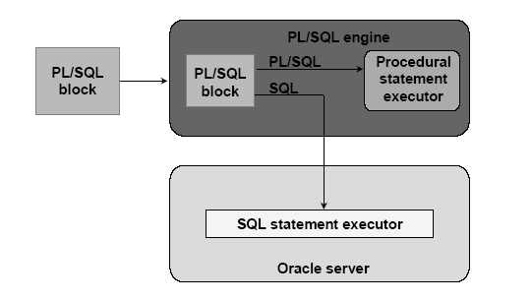
PL/SQL Environment

Slide 5
Benefits
Integrate of database technology and procedural programming capabilities
Provide improved performance of an application
Modularize program development
Portable among host environments supporting Oracle server and PL/SQL
Handle errors

Slide 6
Structure of a Block
DECLARE
/* Declarative section: variables, types, cursors, user-defined exceptions */
BEGIN
/* Executable section: procedural and SQL statements go here. */
/* This is the only section of the block that is required. */
EXCEPTION
/* Exception handling section: error handling statements go here. */
END; /* mandatory */

Slide 7
Block (1)
The only SQL statements allowed in a PL/SQL program are SELECT, INSERT, UPDATE, DELETE and several other data manipulation statements plus some transaction control.
Data definition statements like CREATE, DROP, or ALTER are not allowed.
The executable section also contains constructs such as assignments, branches, loops, procedure calls, and triggers

Slide 8
Block (2)
PL/SQL is not case sensitive. C style comments (/* ... */) may be used.
To execute a PL/SQL program, we must follow the program text itself by: a line with a single dot ("."), and then a line with “run”; or a line with “/”
We can invoke a PL/SQL program either by typing it in sqlplus or by putting the code in a file and invoking the file

Slide 9
Variables and Types (1)
Information is transmitted between a PL/SQL program and the database through variables.
Every variable has a specific type associated with it, that can be:
  One of the types used by SQL for database columns
  A generic type used in PL/SQL such as NUMBER
  Declared to be the same as the type of some database column

Slide 10
Variables and Types (2)
The most commonly used generic type is NUMBER. Variables of type NUMBER can hold either an integer or a real number.
The most commonly used character string type is VARCHAR(n), where n is the maximum length of the string in bytes. This length is required, and there is no default.

Slide 11
Example
DECLARE
price NUMBER;
myBeer VARCHAR(20);

Slide 12
Declaring Boolean variables
Only the values TRUE, FALSE, and NULL can be assigned to a Boolean variable.
• The variables are compared by the logical
operators AND, OR, and NOT.
• The variables always yield TRUE, FALSE, or NULL.
• Arithmetic, character, and date expressions can be used to return a Boolean value.

Slide 13
Example
DECLARE
v_flag BOOLEAN := FALSE;
BEGIN
v_flag := TRUE;
END;

Slide 14
The %TYPE attribute
A PL/SQL variable can be used to manipulate data stored in a existing relation.
The variable must have the same type as the relation column. If there is any type mismatch, variable assignments and comparisons may not work the way you expect.
To be safe, instead of hard coding the type of a variable, you should use the %TYPE operator.
Ex:
DECLARE myBeer Beers.name%TYPE;
gives PL/SQL variable myBeer whatever type was declared for the name column in relation Beers.

Slide 15
The %ROWTYPE attribute
A variable may also have a type that is a record with several fields.
The simplest way to declare such a variable is to use %ROWTYPE on a relation name. The result is a record type in which the fields have the same names and types as the attributes of the relation.
Ex:
DECLARE beerTuple Beers%ROWTYPE;
makes variable beerTuple be a record with fields name and manufacture, assuming that the relation has the schema Beers(name, manufacture).

Slide 16
Default values and assignments
The initial value of any variable, regardless of its type, is NULL.
We can assign values to variables, using the ":=" operator.
The assignment can occur either immediately after the type of the variable is declared, or anywhere in the executable portion of the program.
Ex:
DECLARE
a NUMBER := 3;
BEGIN
a := a + 1;
END;
.
run;

Slide 17
Bind variables
Variable that you declare in a host environment (ex: SQL*Plus), used to pass run-time values (number or characters) into or out of PL/SQL programs
The only kind that may be printed with a print command.
Bind variables must be prefixed with a colon in PL/SQL statements

Slide 18
Steps to create a bind variable
We declare a bind variable as follows:
VARIABLE <name> <type>
where the type can be only one of three things: NUMBER, CHAR, or CHAR(n).
We may then assign to the variable in a following PL/SQL statement, but we must prefix it with a colon.
Finally, we can execute a statement :
PRINT :<name>;
outside the PL/SQL statement

Slide 19
Example
VARIABLE
x NUMBER
BEGIN
x := 1;
END;
.
run;
PRINT :x;

Slide 20
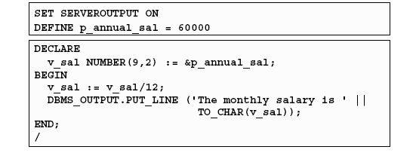
DBMS_OUTPUT.PUT_LINE package
An Oracle-supplied packaged procedure
An alternative for displaying data from a PL/SQL block
Must be enabled in SQL*Plus with: SET SERVEROUTPUT ON

Slide 21
Simple programs accessing the database
The simplest form of program has some declarations followed by an executable section consisting of one or more of the SQL statements with which we are familiar.
After the SELECT clause, we must have an INTO clause listing variables, one for each attribute in the SELECT clause, into which the components of the retrieved tuple must be placed.
The SELECT statement in PL/SQL only works if the result of the query contains a single row. If the query returns more than one rows, you need to use a cursor

Slide 22
Example (SQL)
CREATE TABLE T1(
e INTEGER,
f INTEGER );
DELETE FROM T1;
INSERT INTO T1 VALUES(1, 3);
INSERT INTO T1 VALUES(2, 4);
e | f
1 | 3
2 | 4

Slide 23
Example (PL/SQL)
e | f
1 | 3
2 | 4
DECLARE
a NUMBER;
b NUMBER;
BEGIN
SELECT e,f INTO a,b FROM T1 WHERE e>1;
INSERT INTO T1 VALUES(b,a);
END;
.
run;
a=2, b=4
e | f
1 | 3
2 | 4
4 | 2

Slide 24
Control flow
PL/SQL allows you to branch and create loops in a fairly familiar way.
An IF statement looks like:
IF <condition> THEN <statement_list>
ELSE <statement_list>
END IF;
The ELSE part is optional. If you want a multiway branch, use:
IF <condition_1> THEN ...
ELSIF <condition_2> THEN ... ... ...
ELSIF <condition_n> THEN ...
ELSE ...
END IF;

Slide 25
Example
e | f
1 | 3
2 | 4
DECLARE
a NUMBER;
b NUMBER;
BEGIN
SELECT e,f INTO a,b FROM T1 WHERE e>1;
IF b=1 THEN
INSERT INTO T1 VALUES (b,a);
ELSE
INSERT INTO T1 VALUES (b+10,a+10);
END IF;
END;
.
run;
e | f
1 | 3
2 | 4
14 | 12
a=2, b=4

Slide 26
Loops
Loops are created with the following:
LOOP
  <loop_body> /* A list of statements. */
  END LOOP;
At least one of the statements in <loop_body> should be an EXIT statement of the form
EXIT WHEN <condition>;
The loop breaks if <condition> is true.

Slide 27
Example
DECLARE
i NUMBER := 1;
BEGIN
LOOP
INSERT INTO T1 VALUES (i,i);
i := i+1;
EXIT WHEN i>100;
END LOOP;
END;
.
run;

Slide 28
Other useful loop-forming statements
A WHILE loop can be formed with:
WHILE <condition>
LOOP
<loop_body: Action>
END LOOP;
A simple FOR loop can be formed with:
FOR <var> IN <start>..<finish>
LOOP
<loop_body: Action>
END LOOP;
Here, <var> can be any variable; it is local to the for-loop and need not be declared. Also, <start> and <finish> are constants.

